Slide 1
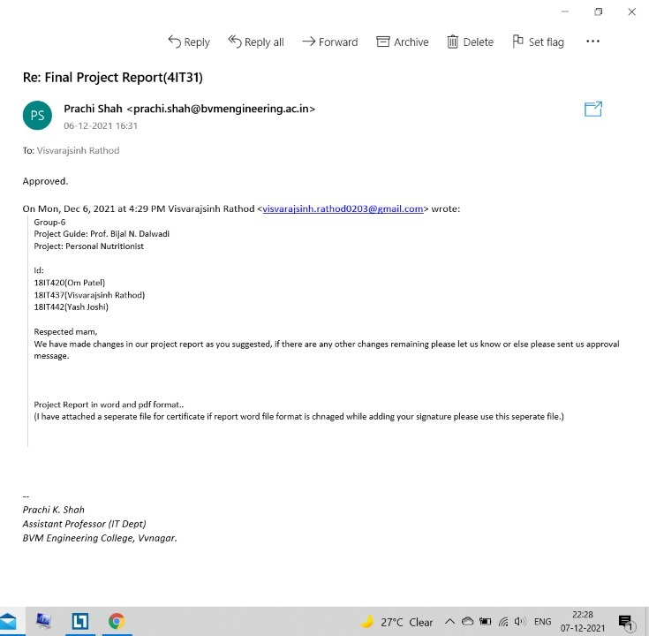
Approval

Slide 2

Birla Vishwakarma Mahavidyalaya
Team Members:
18IT420 : Om Patel
18IT437 : Vishvrajsinh Rathod
18IT442 : Yash Joshi
Dept. : Information Technology
Subject : Project-1 (4IT31)

Slide 3
Personal Nutritionist

Slide 4
Project Definition:
Personal Nutritionist as the name suggests, the system can act as your personal nutritionist while this system can be used also by nutritionists gaining a lot of information and help in many ways.
The user can get details about a number of nutrients, vitamins, proteins, fat, etc., of a fruit or vegetable. The user can add his recipes or get recipes using the API.
The System also allows the user to make a diet plan and remind him of his food timings.

Slide 5
Objective:
Our website Helping people lose weight, maintain a healthy weight, and prevent chronic disease by improving dietary habits requires providing education about food and nutrition, assuring access to healthier food options, and promoting the desire and ability to become physically active.
Scope:
It brings convenience to user as they do not have to leave home and only need to browse website online, especially subscribing famous nutritionists whom they do not have to meet physically.

Slide 6
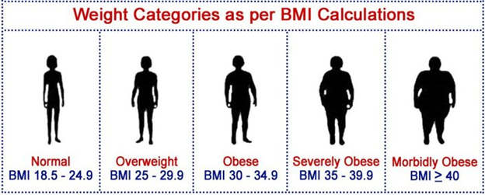
BMI:
BMI stands for Body Mass Index. It is a measure to classify people under the following categories: underweight, normal weight, overweight and obese. It is the ratio of your weight in kilograms to the square of your height in meters. People with high BMI have too much body weight or body fat for their height.

Slide 7
How to calculate BMI ?
To calculate BMI, you are required to have two values: a person's height in meters and his weight in kilograms. If the height is in inches, weight should be in pounds. The formula to calculate BMI is as follows:
BMI = weight in kilograms / (height in meters) 2
Or
BMI = weight in pounds / (height in inches) 2 X 703 (if pounds and inches are used, a conversion factor of 703 must be applied).

Slide 8
Modules:
1.User
Daily Progress
Blogs saved
Subscribed Nutritionist
Your Friends
1.1 Set Profile
1.2 Dash Board
1.3 Food
1.4 Recipes
1.5 View blogs

Slide 9
2.Nutritionist
2.1 Set Profile
2.2 Dash Board
2.3 Followers
2.4 Recipes
2.5 Create and Post Blogs

Slide 10
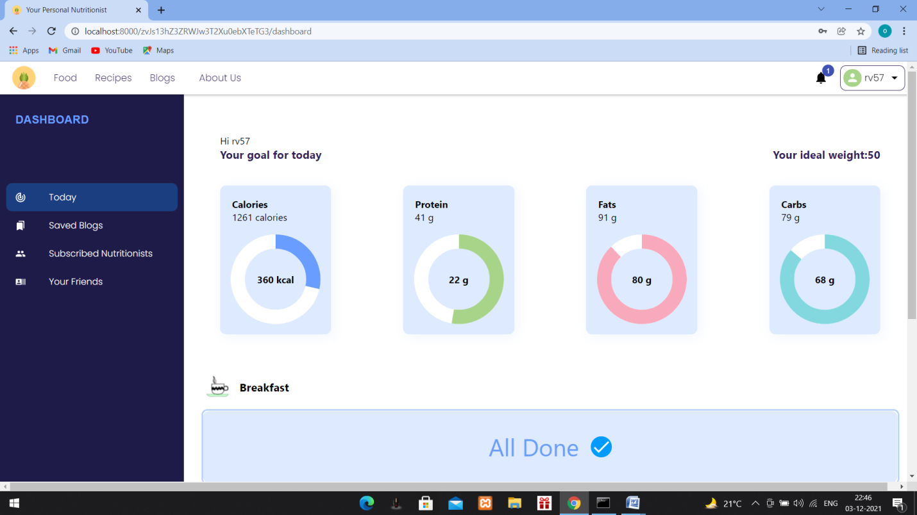
Extra Features

Slide 11
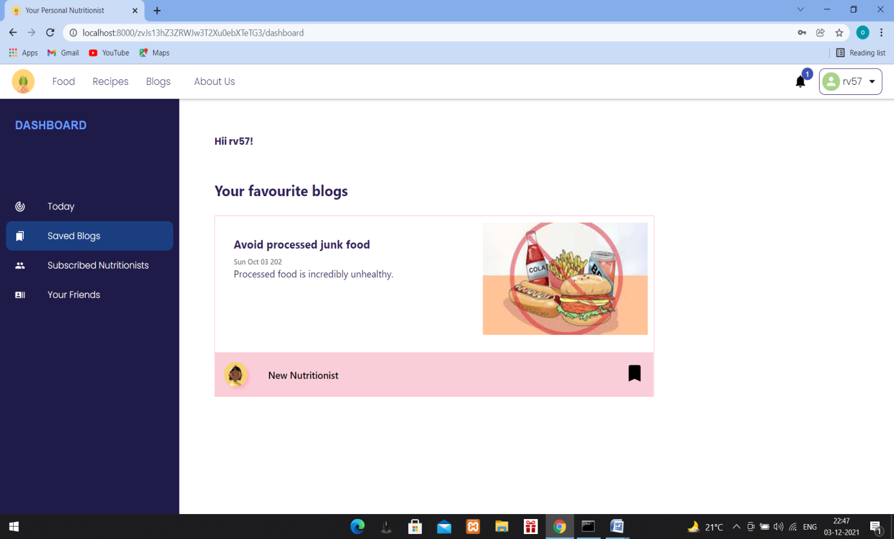
Save blogs in profile..

Slide 12
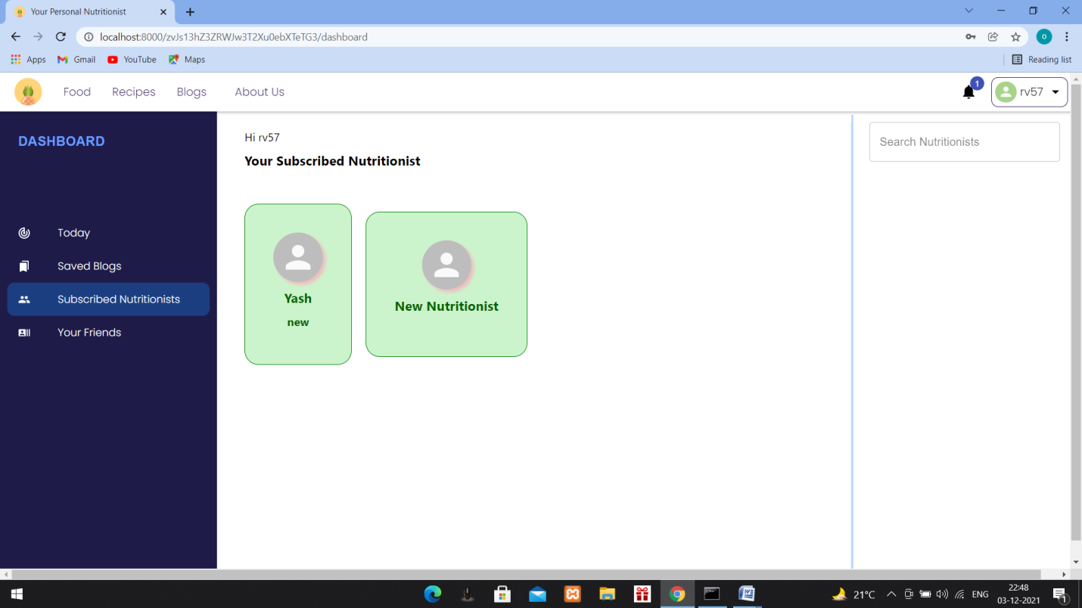
Subscribe/follow nutritionists..

Slide 13
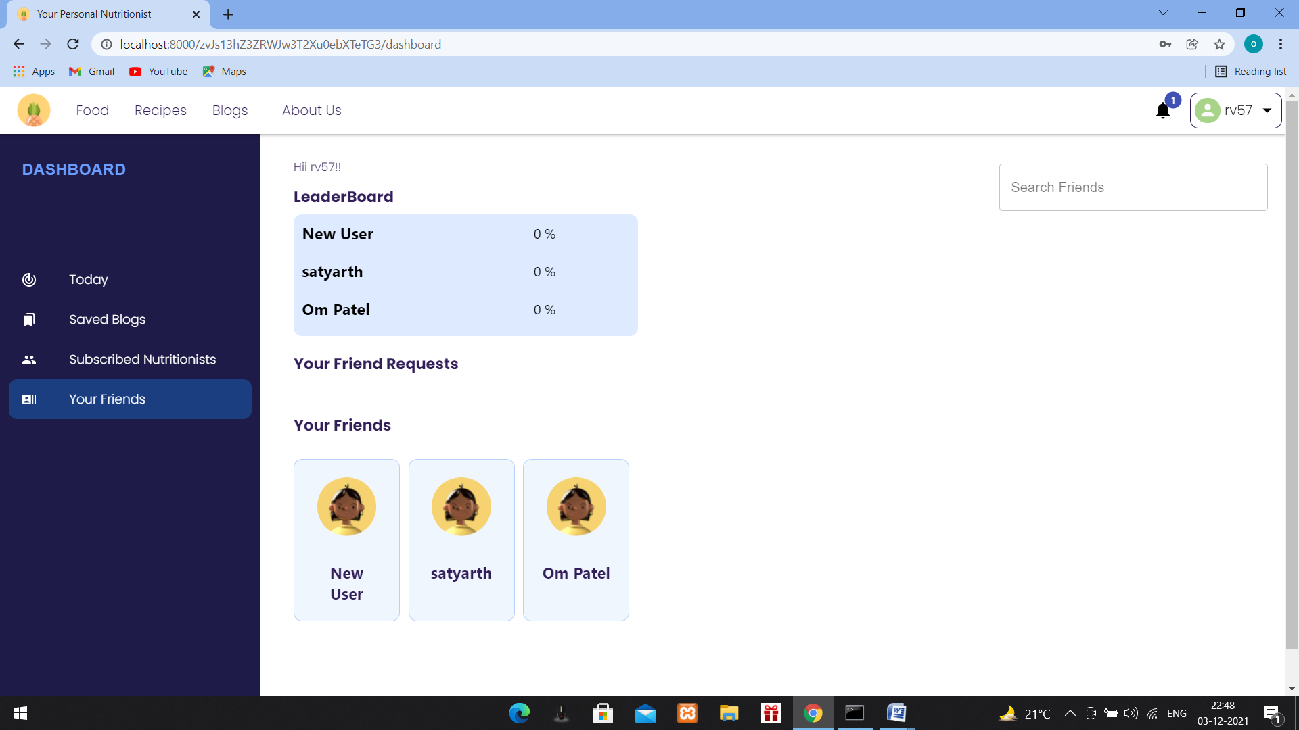
Make friends and follow diet plans together

Slide 14
React js and Node js based Web App:
Software and Tools Used:
Vs Code
Node js
NPM Fire base

Slide 15
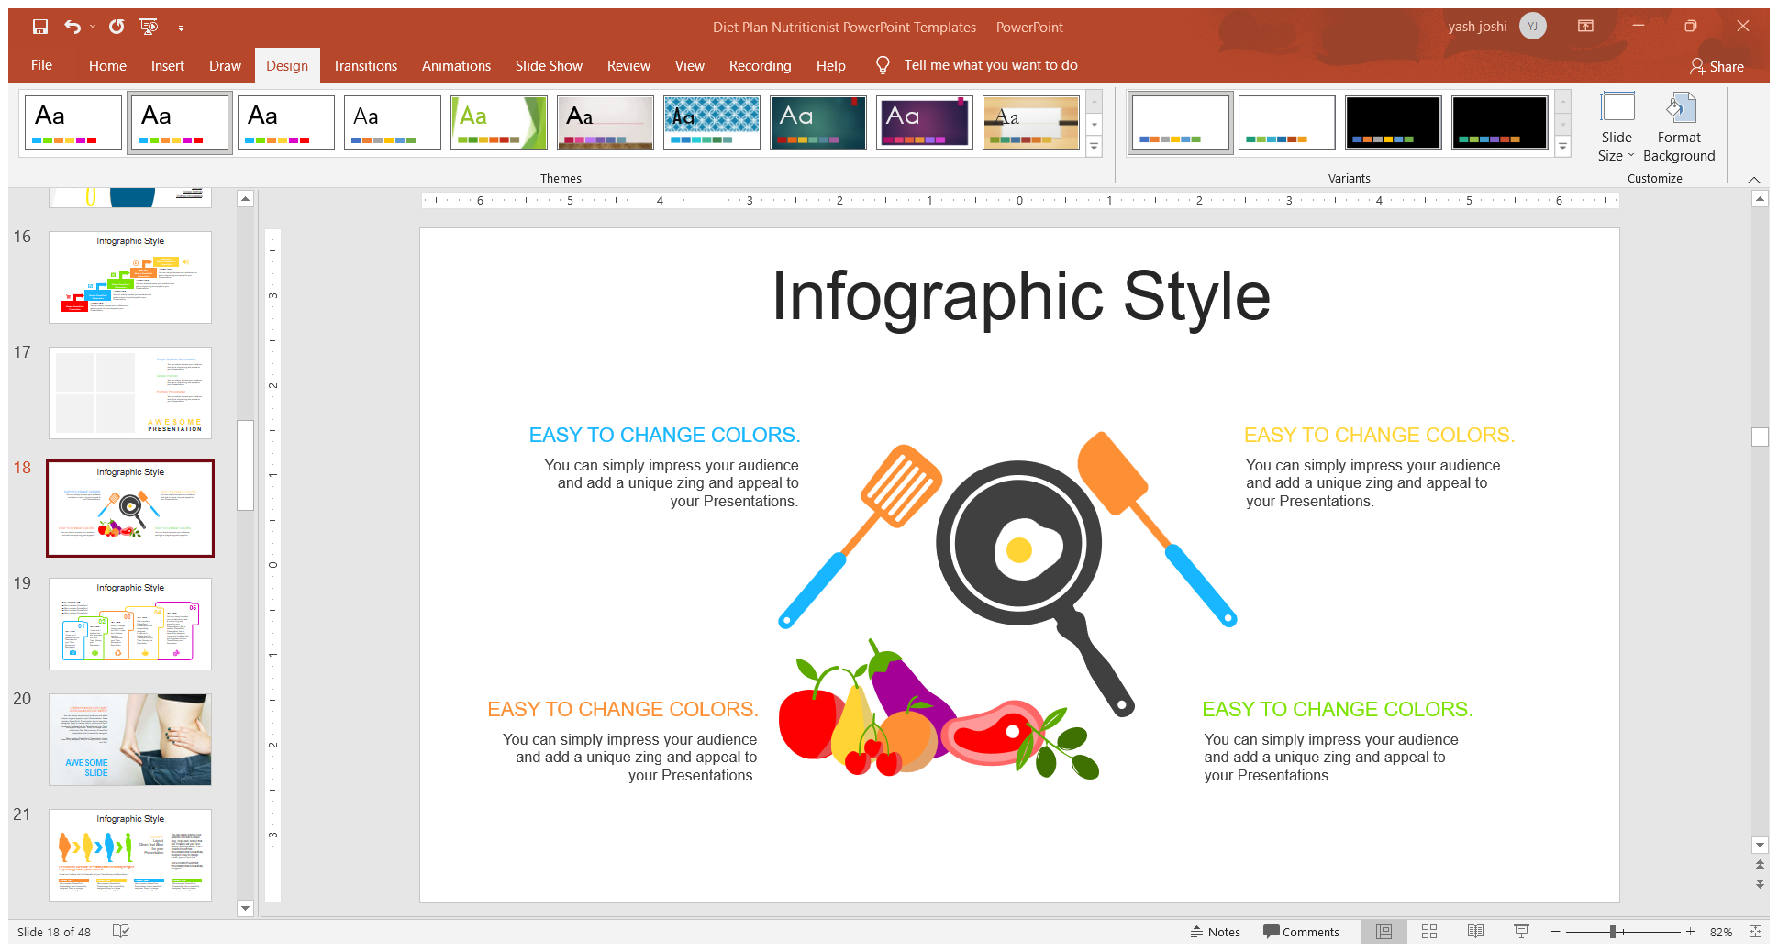
Nutrition API by Nutritionix:
It fetches the data from the food page.
It gives the food image and nutrition's according to the input food.
Which helps us count for how much exercise do we have to do to burn that much calories which we will get from that food item.

Slide 16
Spoonacular recipe and food API
Search recipes :
We Search through hundreds of thousands of recipes using advanced filtering and ranking. This method combines searching by query, by ingredients, and by nutrients into one endpoint.
Search Recipes by Nutrients :
We can Find a set of recipes that adhere to the given nutritional limits. You may set limits for macronutrients (calories, protein, fat, and carbohydrate) and/or many micronutrients.

Slide 17
Get Recipe Information :
We can Use a recipe id to get full information about a recipe, such as ingredients, nutrition, diet and allergen information, etc.
Ingredient Search :
Search for simple whole foods (e.g. fruits, vegetables, nuts, grains, meat, fish, dairy etc.).

Slide 18
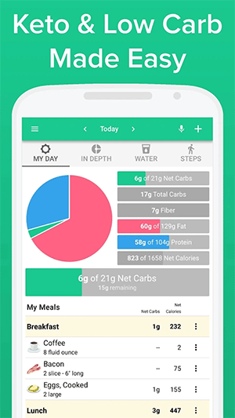

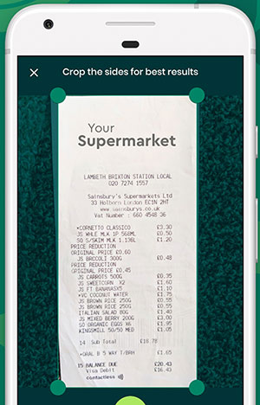
Similar Existing Applications
1. Carb Manager 2. Create My Cookbook 3. Kitche

Slide 19
How it differs from our webapp
As you can see above all apps/Websites are doing only main task as get recipe or keep track off carbs you're eating.
It doesn’t advise or make a schedule for you to lose carbs or get you a healthy recipe for your chosen ingredient.
In contrary our website is doing more than a personal dietritionist or nutritionist .
You just have to enter your body measures and it will make a perfect plan for you , suggestions of exercises, give you the recipes form the ingredient and nutrition limit you have set.

Slide 20
Thank You

